Slide 1
Mindful Breathing & Concentration
Straight back, folded legs if you are sitting on a matt or cushion, or legs grounded if on a chair
Chin slightly tugged in or dropped to feel at ease
Hands resting on the knees or thighs with palms upwards
Eyes slightly opened to see barely your knees or closed
Tongue lightly touching the upper palette
Lips closed, teeth not biting
Shoulder relaxed

Slide 2
Private Victory
Private Victory is when we learn self mastery and self-discipline
I am a product of my choice and not my circumstance (proactive or choice)
I live by design and not by default (vision or end in mind)
I put important things first and not urgent things first (integrity)

Slide 3
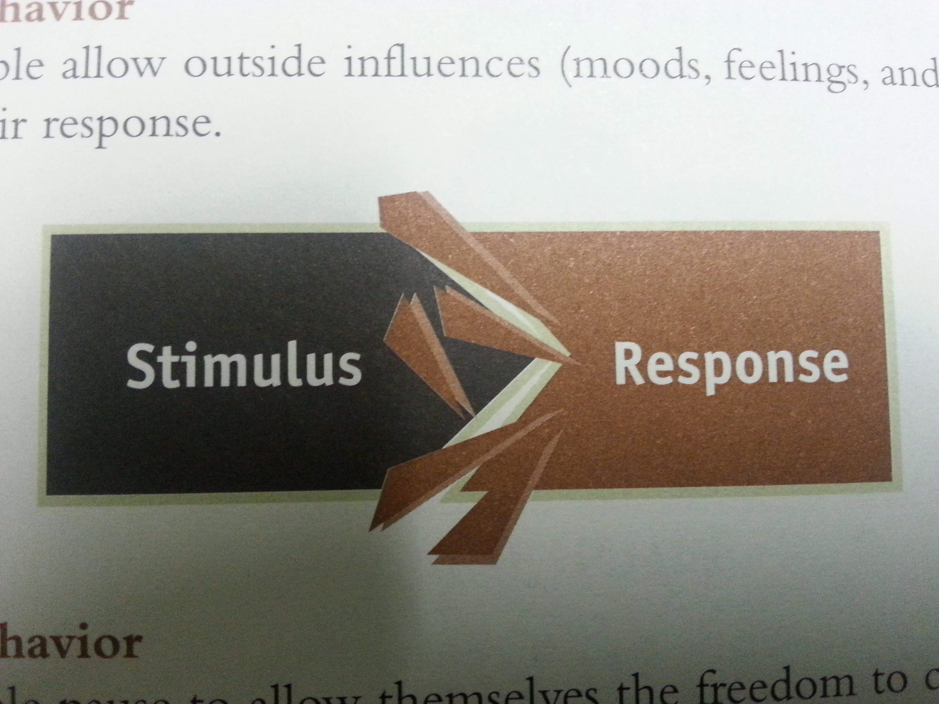
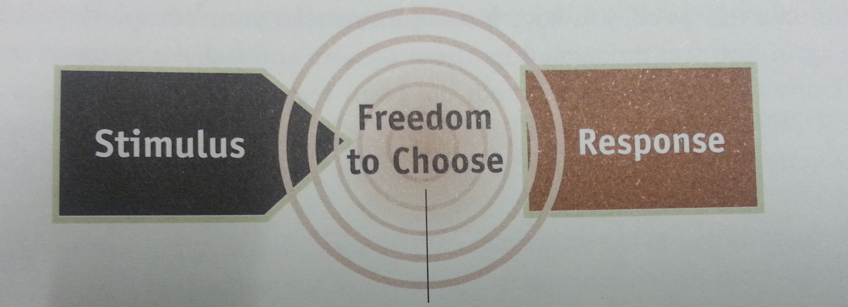
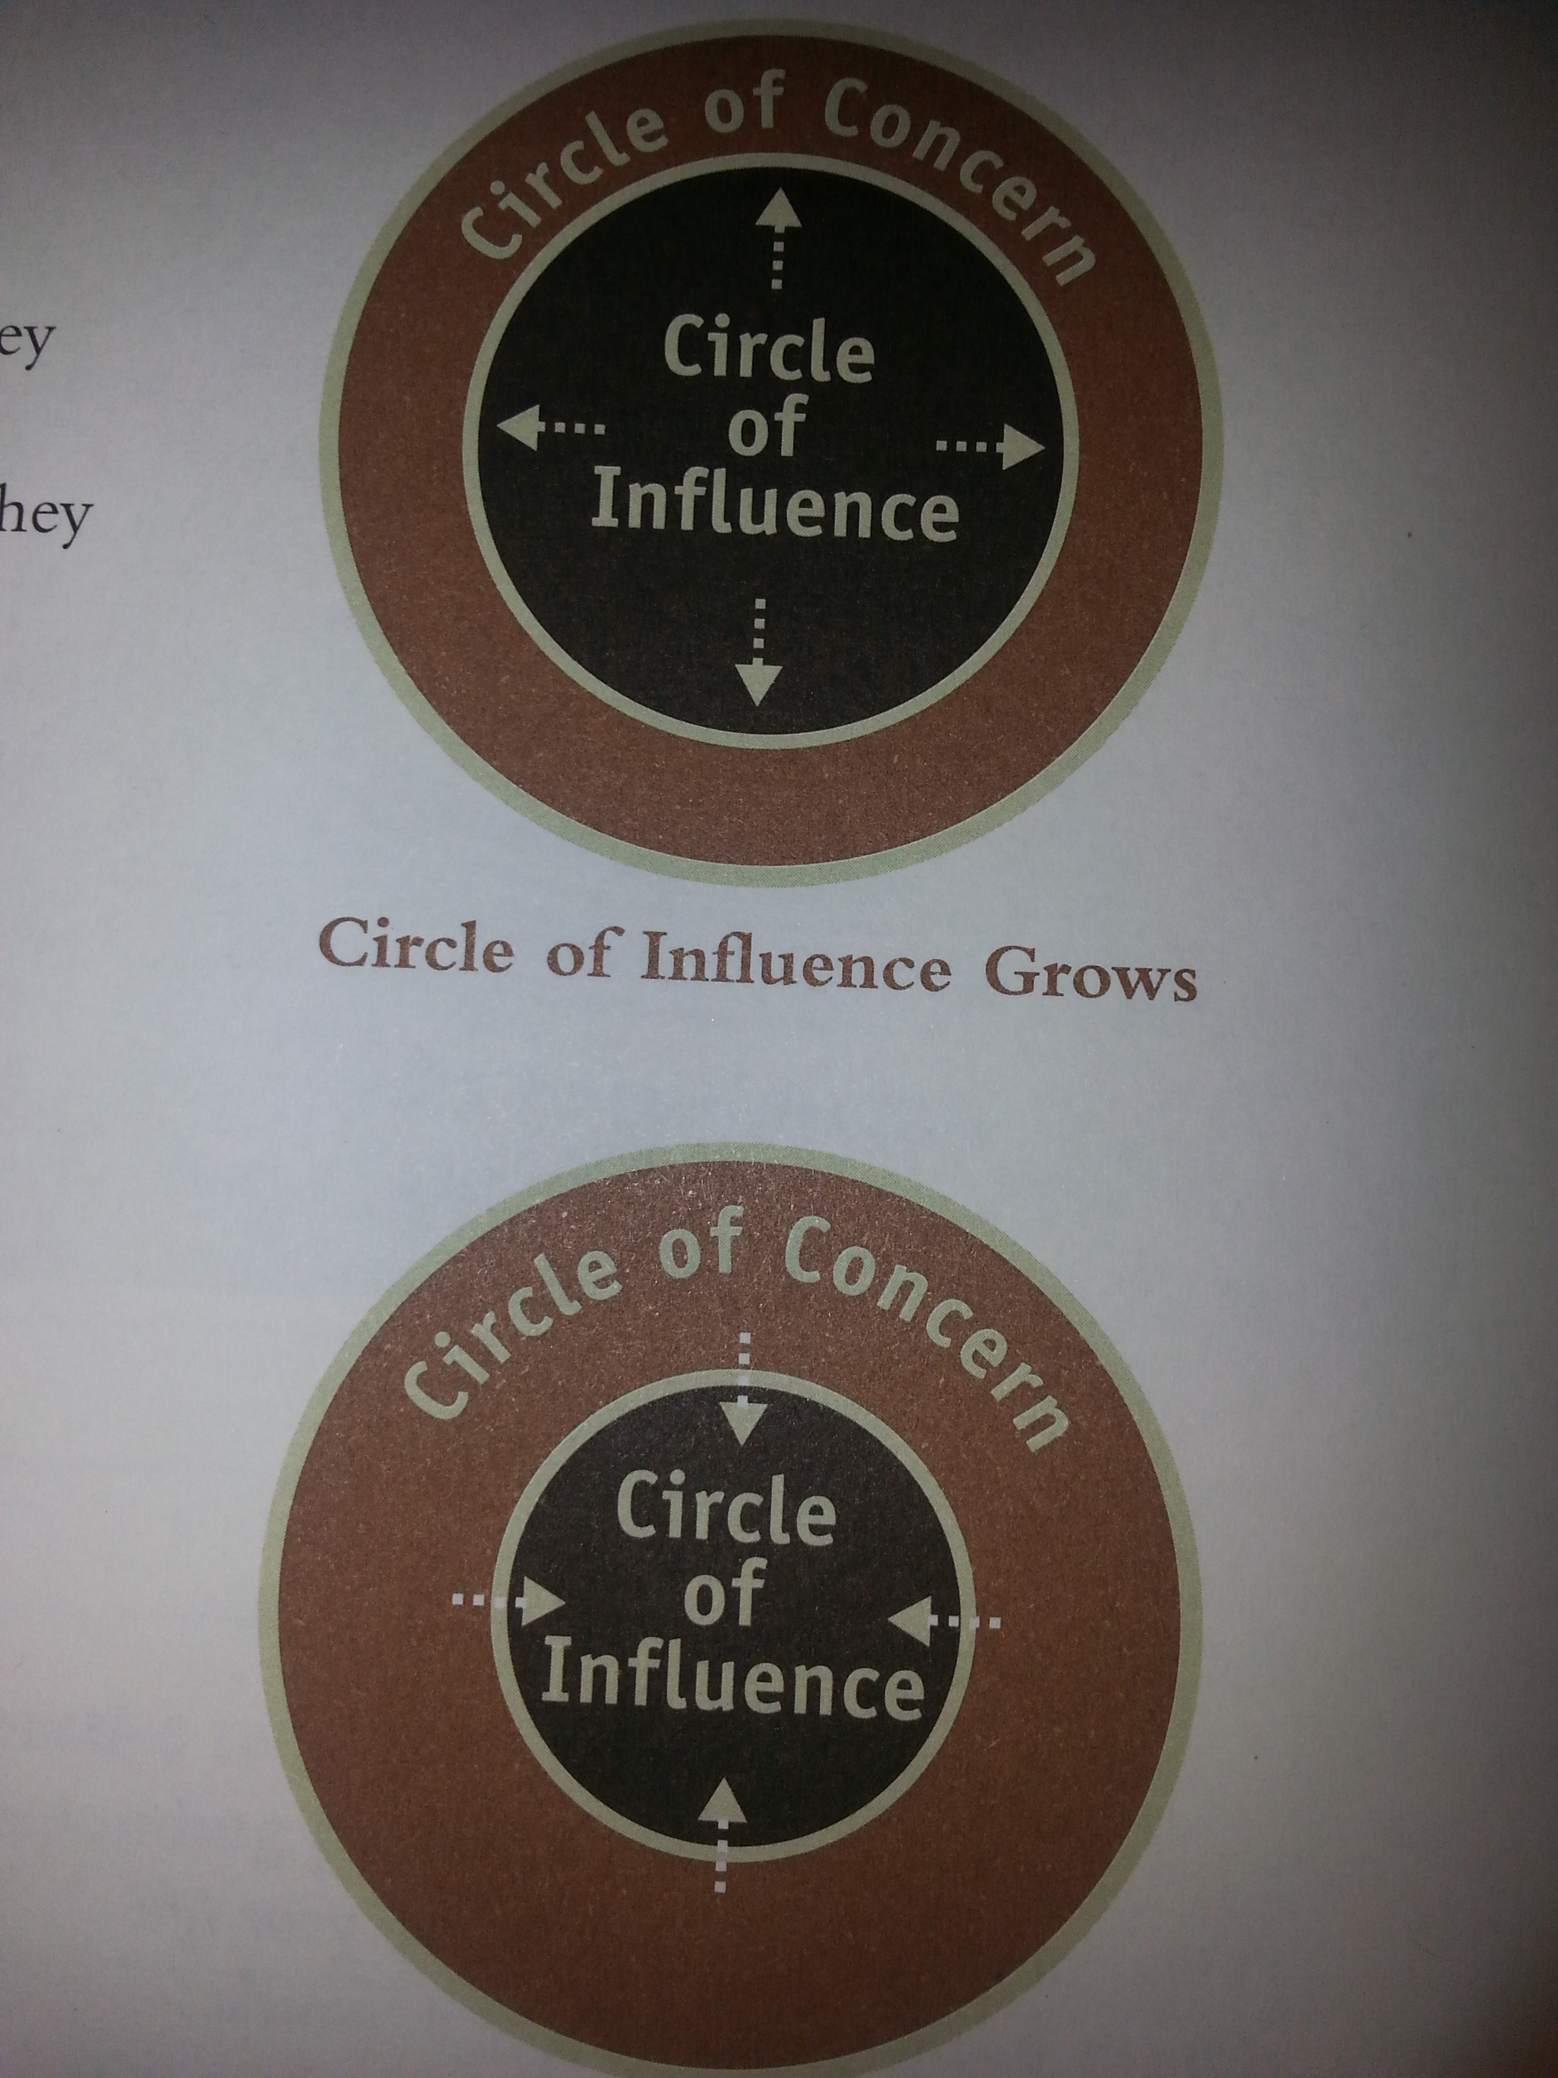
I am a product of my choices and not circumstance
You are free to chose but you are responsible for your choice
Pause & respond
Use proactive language (I want instead of I need, I prefer instead of I must, I chose instead of I can’t)
Expand your circle of influence
Become a transitional person

Slide 4
I live by design not by default
Mental creation precedes physical creation
Envision outcomes before you act (story of Alice in the wonderland)
Create and live by a personal mission statement

Slide 5
Example of Mission Statement: Mahatma Gandhi
Mahatma Gandhi's mission is captured in a short list of active statements. You can craft your mission in this style, starting each sentence with "I shall" or "I will."
Let the first act of every morning be to make the following resolve for the day:
I shall not fear anyone on Earth.
I shall fear only God.
I shall not bear ill will toward anyone.
I shall not submit to injustice from anyone.
I shall conquer untruth by truth.
And in resisting untruth, I shall put up with all suffering.

Slide 6
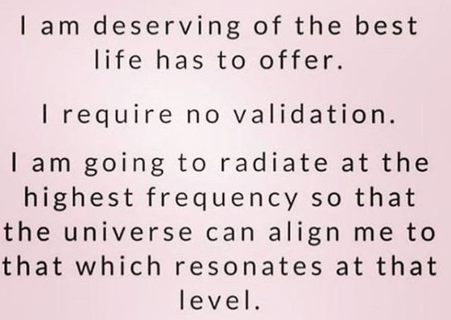

Slide 7
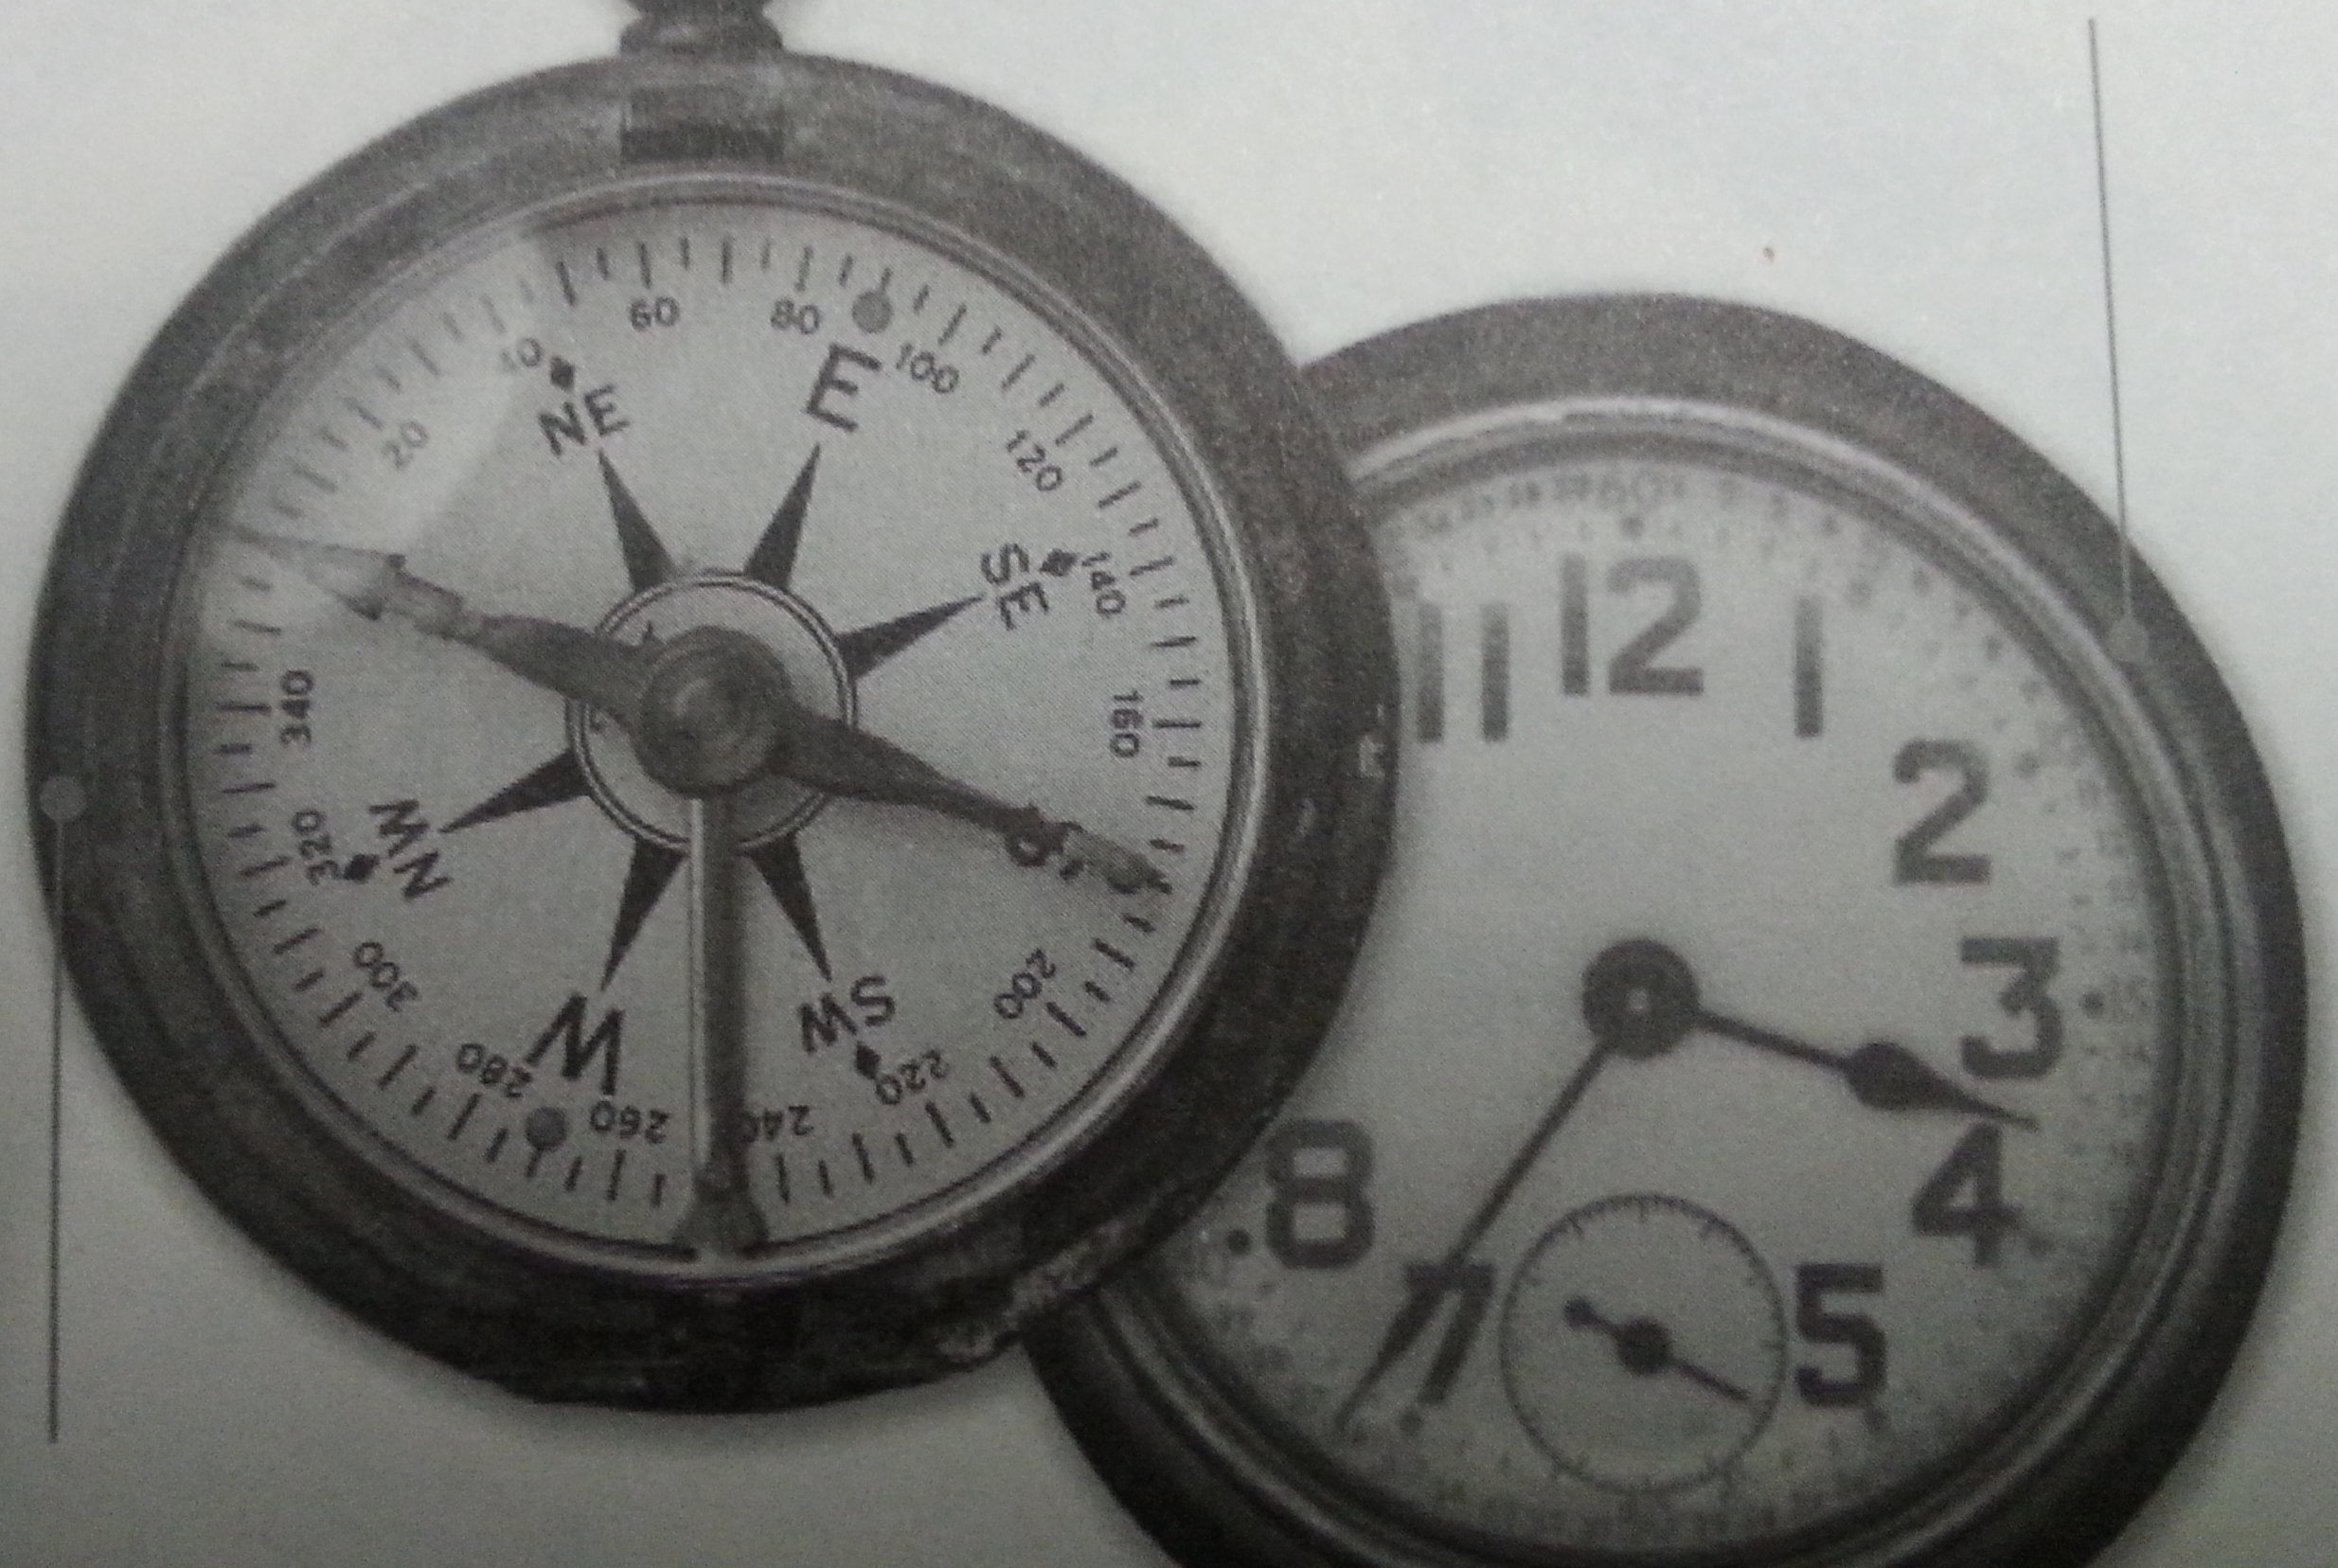
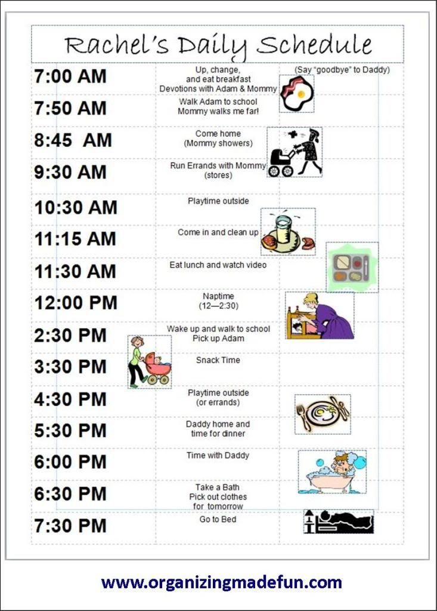
I put important things first and not urgent things first
Effectiveness requires the integrity to act on your priorities
Focus on top priorities
Eliminate the unimportant (Time Matrix)
Plan weekly & daily (20 min every week)

Slide 8
Time Matrix
Urgent
Not Urgent
Table 1
I Crises Pressing problems Deadline-driven projects, meetings, reports | II Preparation Prevention Planning Relationship building Re-creation Values clarification
III Needless interruptions Unnecessary reports, meetings, phone calls, emails/mails, social media Other people’s minor issues | IV Trivia, busywork Irrelevant phone calls, emails/ mails Time wasters Excessive TV, internet, Escape activities
Important
Live above this line
Not important
Important: activities represent your values, mission, priority goals
Urgent: activities that require immediate attention

Slide 9
Self-mastery makes us effective people
Highly effective people are proactive, they take initiatives, achieve the right goal, and remain in integrity.
They do not impose limit on to themselves that may prevent them from acting.
They recognize that they have the freedom to determine the kind of character they will have.
They may not be able to control their circumstances, but they can decide how to make the best use of those circumstances.

Slide 10
Class Exercise
Imagine yourselves celebrating 80th birthdate – you have invited you children, grandchildren, neighbours, and friends.
Everyone is wishing you
Do you wish to only hear – Happy Birthday Rita, grandma, mother, etc? Is that how you want to be wished?
If not, you must change it. You must take hold of your life.
You can begin by drafting a personal mission statement that outlines your goals and describes the kind of person you want to be.

Slide 11
Journaling
Vision your journey of life with end in mind
What are the three top goals for me this year?
How will I know if I reach them?
Discover yourself ; Self-awareness:
I am at my best when ….
I am at my worst when….
What do I really love to do at work?
What do I really love to do at my personal life?
My natural talent and gifts are?
Discovering yourself; Imagination:
If I had unlimited time and resources, what would I choose to do?
Possible life goals for me are….
I want to be a person who….
Discover yourself ; Conscience:
What do I consider to be my most important future contribution to others?
Are there things I feel I really should do, even though I may have dismissed such thoughts many times? What are they?
Reflect on three people who have influenced your life and write their names and attributes.
Draft your personal mission statement (5 min, keep pen moving until something comes to your mind, never mind what it looks like).

Slide 12

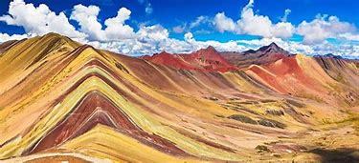
Happiness is here and now, I have dropped my worries, nowhere to go, nothing to do, and I am not in a hurry. Happiness is here and now, I have dropped my worries, somewhere to go, something to do, but I am not in a hurry
May you be well and happy always
May you find happiness in what you do
May you bring happiness to the lives you touch
May you be the northern star for yourself, family, friends, society and the world.

Slide 13
